Slide 1

TELEMATICS CONTROL UNIT.
VehiclePlus

Slide 2



Slide 3
Meet Our Team
Moustafa Wahdan
Youssef Abbas
18105075
18106295
Ahmed Tarek
Mohamed Nabil
18105515
18106135
Nada El-Etr
Ahmed Samir
18105970
18105723
Toqa Elkabany
Mina Nadi
18105165
18104792
Ali Samir
Mohamed Emad
17104633
17204009

Slide 4
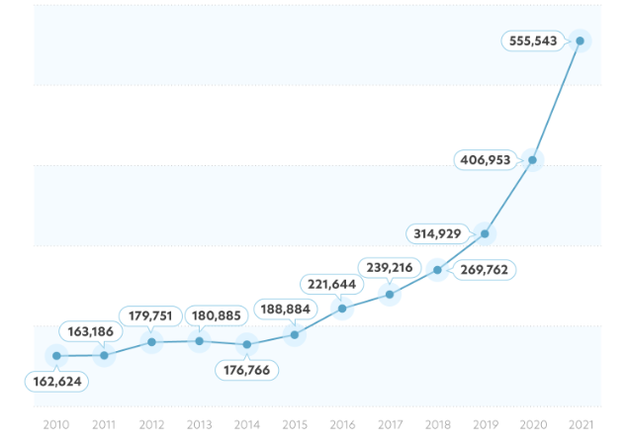
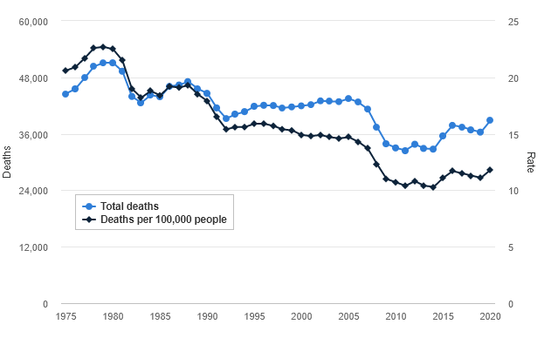
Problem Statement
According to the U.S. Department of Transportation there were an estimated 6.8 million police-reported crashes in 2019, resulting in 36,096 fatalities and an estimated 2.7 million people injured.
FBI has reported that 810,400 vehicles were stolen in 2020, up 11.8% from 2019, when 724,872 vehicles were stolen.
FBI report on number of vehicle thefts per year( vivint.com )
U.S. Department of Transportation started an annual census ( iihs.org )
FBI report on number of vehicle thefts per year( vivint.com )

Slide 5
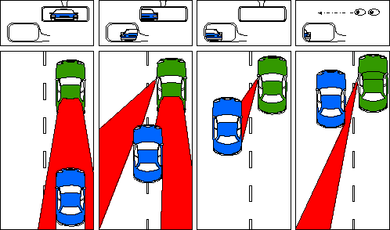
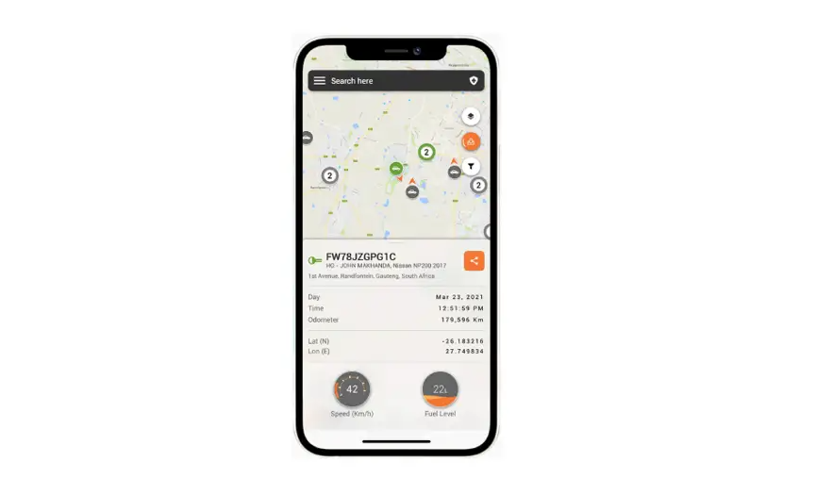
Problem Statement
A blind spot happens when your car's side mirrors cannot glimpse any sign or reflection of other vehicles nearby when you are backing up or changing lanes which could lead accidents.
Driver unawareness causes fatal crashes.
A user wants to have easy access to his car features and constantly receive notifications from his vehicle to his mobile device.

Slide 6

Literature Review

Slide 7
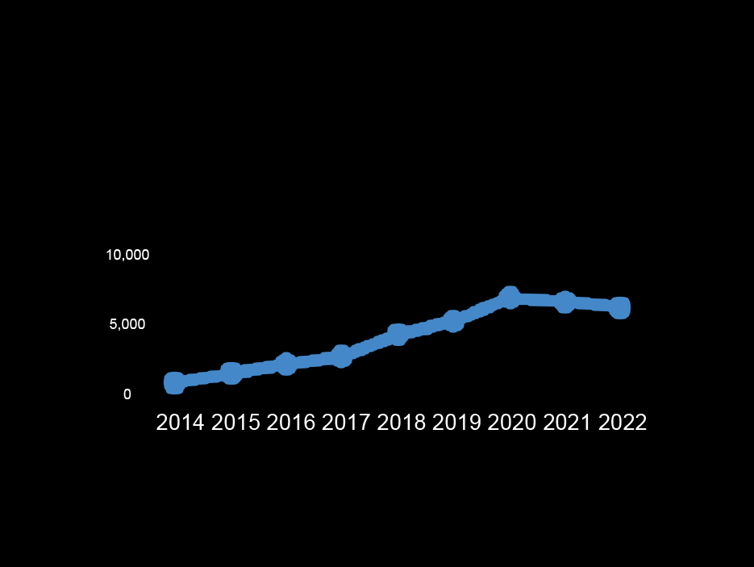
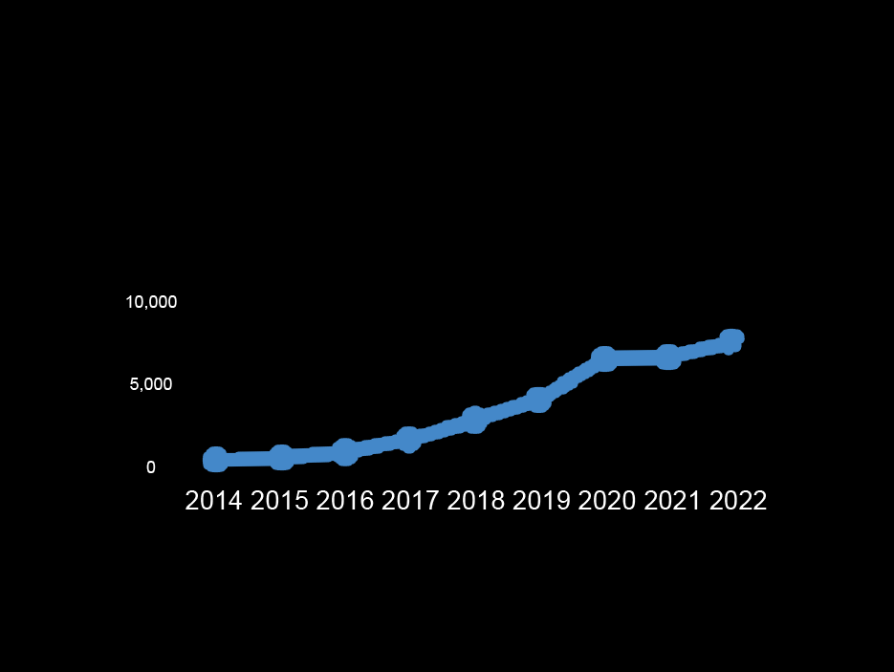
Literature Review
Vehicle telematics researches, journals and articles
V2V researches, journals and articles
The research about vehicle to vehicle communication systems has been booming for the last three years
that there has been over 653k of research papers, journals and articles in the last 8 years. ( according to app.dimensions.ai )

Slide 8
OUR PROJECT MOTIVATION
The main motivation for our project is to provide features that aids to minimize road accidents and try to secure the car from thefts this goal can be achieved by providing the car with 360-degree awareness of similarly equipped vehicles within a range using V2V technology.
Vehicle-to-Vehicle (V2V) communications among nearby vehicles in the form of continuous broadcast of Basic Safety Messages (BSMs) has the potential to prevent up to 75% of all roadway crashes through active safety applications. Basically, BSM(basic safety messages) are shared using V2V communication to provide a safer driving journey. The correctness and reliability of BSMs, which contain information like sender's position, speed, etc., are of prime importance as they directly affect the outcome and effectiveness of safety applications based on them.
A user wants to have easy access to his car features from his mobile device
A user needs to have continuous updates about what’s going on with his vehicle
Modern vehicles need cloud services for them to extend their functionalities.
Bad usage of vehicles could lead to serious problems for the driver and his surrounding environment. An automated crisis management system is needed in order to avoid this from happening

Slide 9
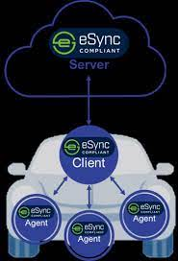
Solution proposed
Implement a vehicle telematics system that is
Secure
Robust and Reliable
Accountable
Flexible
User friendly
Following Autosar ,IEEE and ISO standards

Slide 10
Telematics control unit

Slide 11
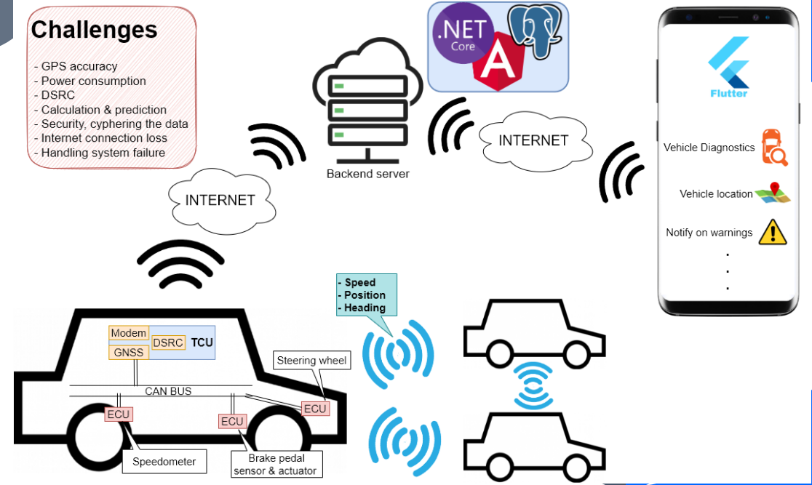
Brief system architecture
Ethernet

Slide 12
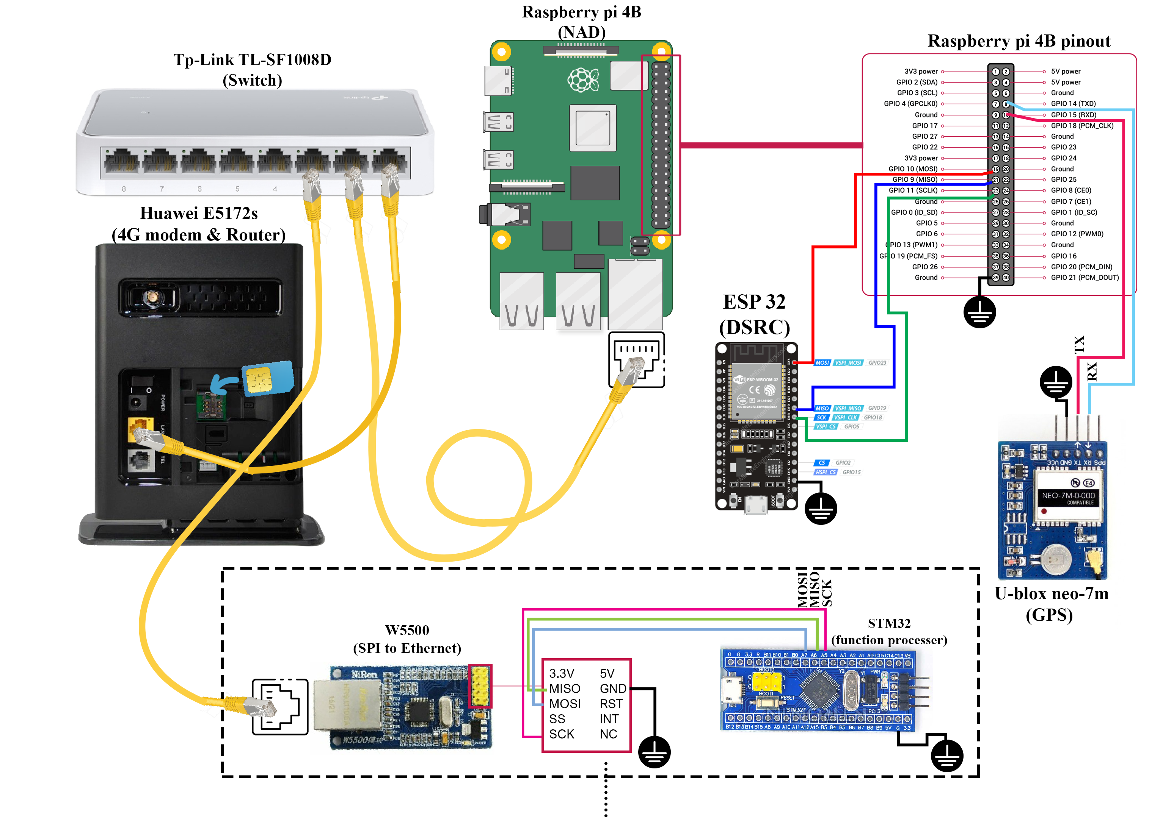

Slide 13
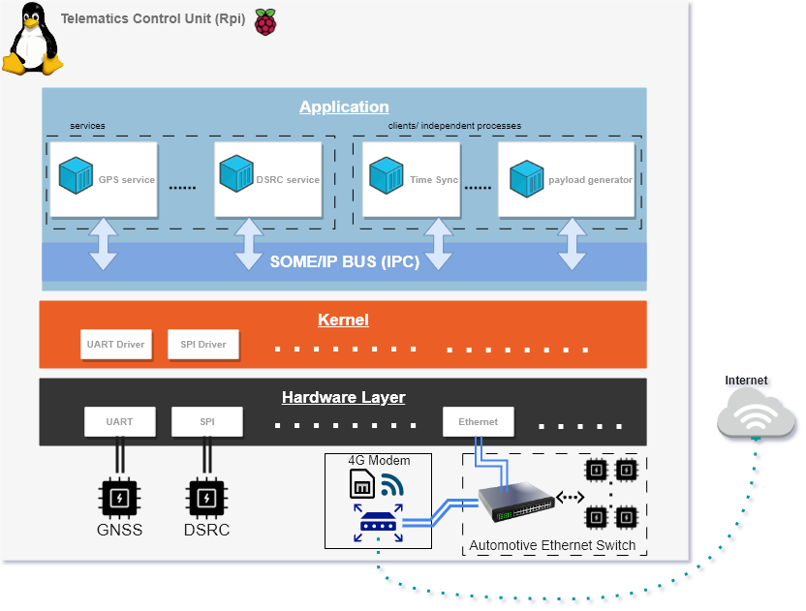

Slide 14
Localization (GNSS)

Slide 15
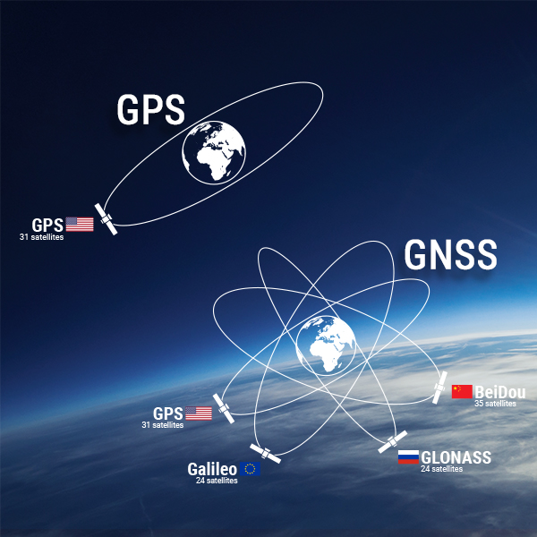
Objective
GNSS is used in systems that track and forecast the movement of vehicles and monitor road networks, improving efficiency and enhancing driver safety.
We use Our GNSS module for vehicle localization to be streamed to
Users on there mobile app and to be used in the V2V communication
To prevent car crashes.
Our module ( U-blox neo-m7 ) can only capture GPS satellite signals.
More accurate GNSS’ receivers can capture other satellite signals.
We use it in the V2V (BSM) to help safety applications in crash avoidance.

Slide 16
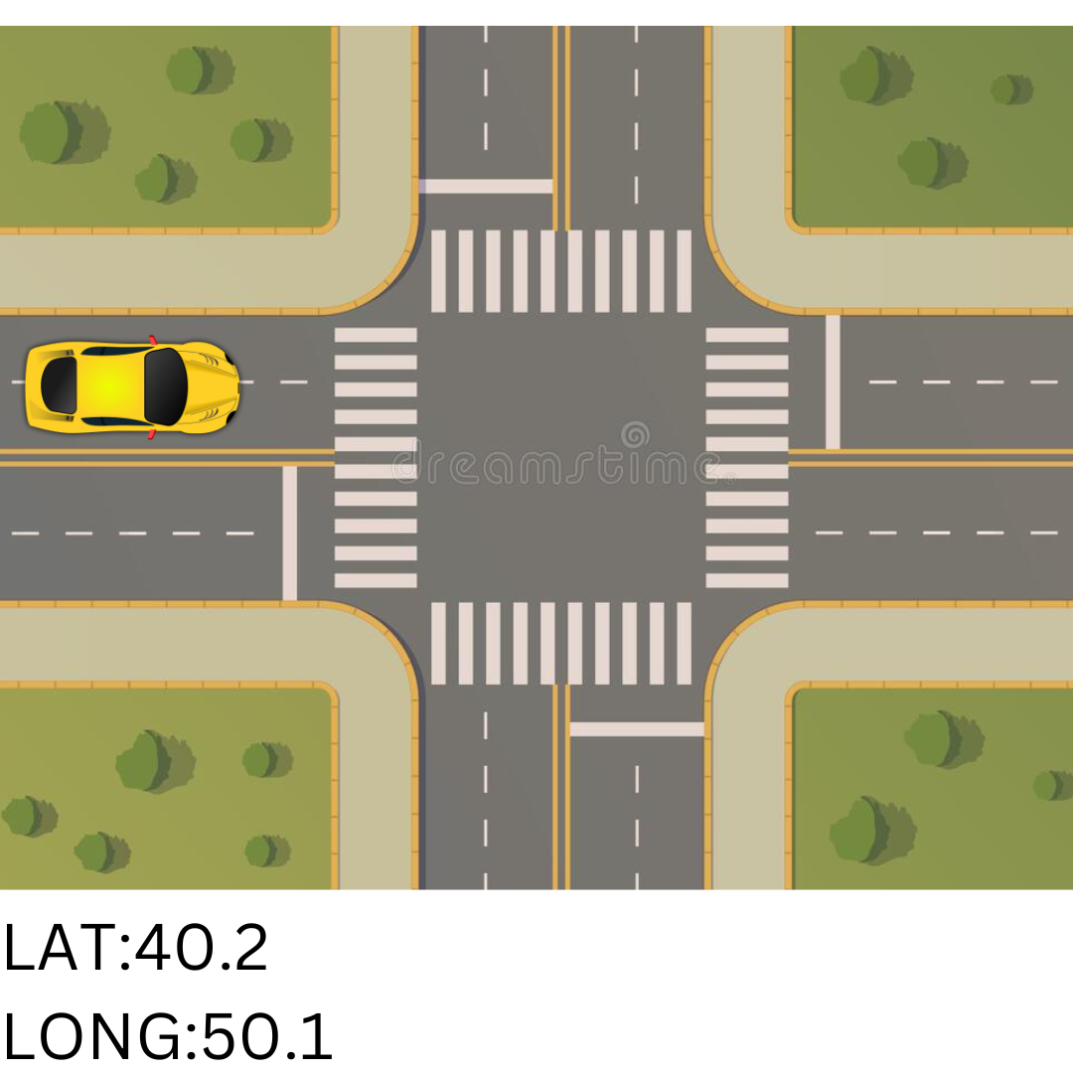


So GNSS is enough?
Awesome! So we forward this data Backend server and use it prevent
Traffic incidents via V2V comm. 😊
Well not really 😐
The GNSS by it self is not really this accurate with error of +- 5m
Even if you used a high power receiver still the error is not tolerated in V2V applications

Slide 17
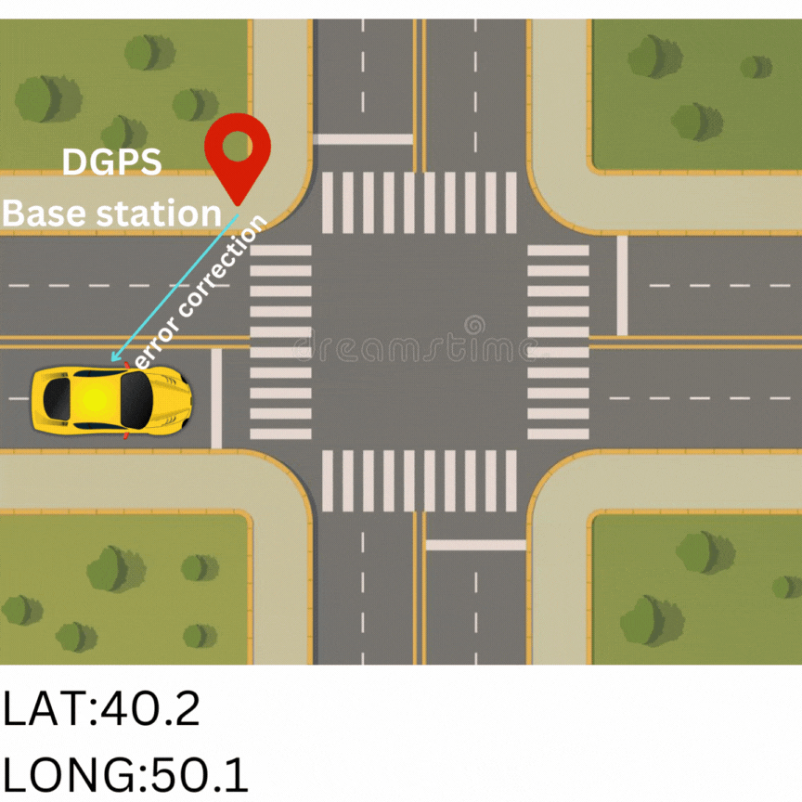
DGPS
Differential Global Positioning Systems (DGPSs) supplement and enhance the positional data available from (GNSSs). A D-GPS can increase accuracy by about a thousandfold, from approximately 15 metres (49 ft) to 1–3 centimetres

Slide 18
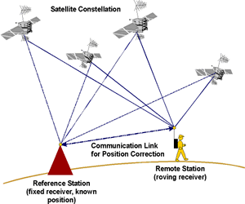
How we would implement D-GPS
We would use ESP8266/32
GPS module
connect the ESPs with antennas for large distance coverage
We get accurate position of each D-GPS station by using very high accuracy GPS modules for long time (to overcome error variance)

Slide 19
Localization Improvement

Slide 20
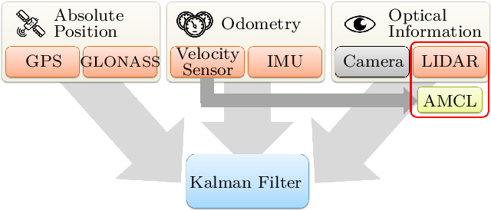
Localization Improvement Algorithm
Kalman filters are used to optimally estimate the variables of interests when they can't be measured directly, but an indirect measurement is available. They are also used to find the best estimate of states by combining measurements from various sensors in the presence of noise.

Slide 21
Localization Improvement using ML

Slide 22
Plan
GPS + Speed + Heading
Theoretically, You have a hand-held map, and a mark of your initial point, you have a speedometer, and a compass.
You can with some level of accuracy determine your position while moving. (I moved at 1m/s toward north for duration 1 second; then I must be 1 meter toward north than my initial point)
This algorithm depends mainly on accurate measurement of geographic location specially at the initial point

Slide 23
Plan
However, some drift may occur due to any of the used sensor's inaccuracy.
To solve this issue. At any time, the car move at relatively slow speed or when stopped at any moment (due to traffic or parked, etc.) a new GPS reading is made and assume to be accurate to be considered as a true geo location reference for recalibrating the output location.
The point of trusting GPS readings while standing still is that we can average many latitude and longitude readings from the GPS sensor to overcome the range of error in the sensor (+/- 10 meters).

Slide 24
Plan
The simulation of this idea is appliable, however, the main idea of using a machine learning model is to provide a weighting factor to each sensor reading.
In an algorithmic approach, I may not be able to decide which reading to consider as more accurate (due to variance of error in GPS readings).
This idea is still under research, debatable & experientable.

Slide 25
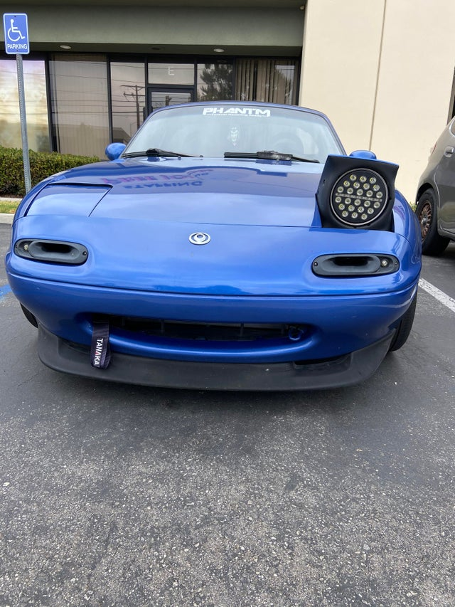
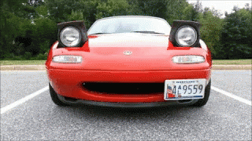
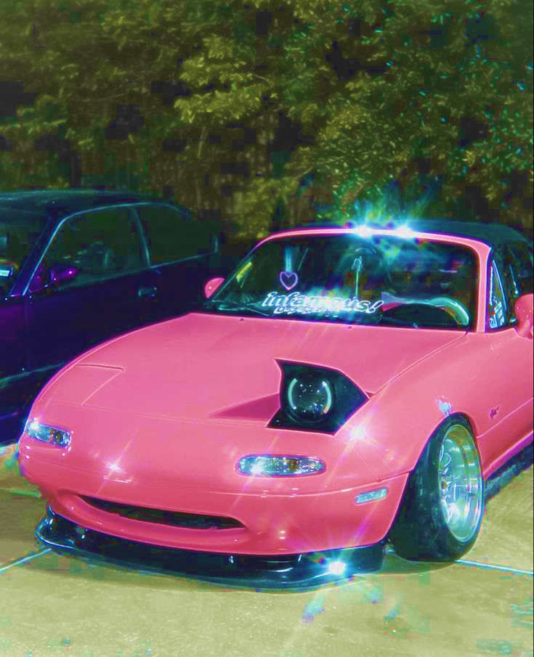

V2V Vehicles Identification
Hey, it’s me
McQueen
Doc Hudson
Hicks
FLO

Slide 26
V2V Vehicles Identification
Along with timestamp, Vehicle identification is a very essential and critical information to share whenever a payload from a vehicle is being shared with other vehicles.
In our current implementation during testing process, we have used MAC address of the ESP-32/8266 module (DSRC alternative) as vehicles unique identifier (which may not be sufficient in real world use)
Each vehicle has a ESP-32/8266 module, Assuming no-repeated MAC addresses (unreliable but sufficient for development processes), each vehicle can compare the MAC address of each payload sender to identify if it’s a new vehicle or an already seen vehicle

Slide 27
V2V Vehicles Identification
For new vehicles, A new vehicle structure is created for this vehicle with a timer for removal in case of absence of updated data for a certain amount of time (no signal coverage means long enough distance to neglect this vehicle) this vehicles data structure will be removed.
When receiving a payload from an already seen vehicle and timeout period has not yet been exceeded (MAC address and vehicle’s data still in memory), this vehicle’s data is then updated for sharing with the ECU (Raspberry pi through SPI) to take informed decisions when needed

Slide 28
Secure V2V channel

Slide 29
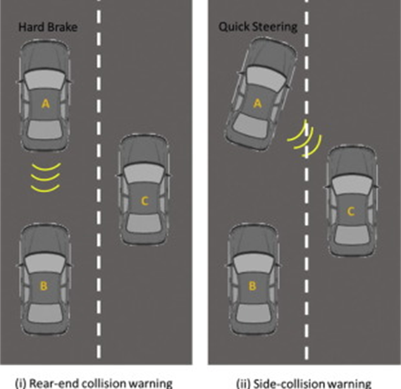
Secure V2V channel
Vehicle-to-Vehicle (V2V) communications among nearby vehicles in the form of continuous broadcast of Basic Safety Messages (BSMs) has the potential to prevent up to 75% of all roadway crashes through safety applications.
Basically, BSM(basic safety messages) are share using V2V communication to provide a safer driving journey. The correctness and reliability of BSMs, which contain information like sender's position, speed, brakes, etc., are of prime importance as they directly affect the outcome and effectiveness of safety applications based on them

Slide 30





Red light violation
Hacker creates a “fake” traffic light
The fake traffic light sends a red violation warning
Vehicles receives the fake warning and driver brakes immediately
Full braking causes a rear-end collision

Slide 31
Traffic Chaos Attack
Hacker creates fake cars
Fake cars send a lot of fake signals
Traffic light reacts to intense traffic and turns green
All other cars must wait which causes a traffic jam

Slide 32
Safety Applications Attack
Hacker creates fake cars
Fake cars send a lot of fake signals
Safety applications of receiving vehicles act upon the received fake BSM signals and takes mis-led decisions
Fake decisions and warnings lead to put driver and passengers of the mis-led vehicle in danger and its the surrounding vehicles and passengers.

Slide 33
Solution
To prevent an attacker from inserting false messages, most studies recommend that the sending vehicles digitally sign each BSM, and the receiving vehicles verify the signature before acting on it.
Basically, this topic is very important for our application. However, it is not our main concern currently in our project. we may later work on applying a security solution to try to solve threads facing V2V communication.

Slide 34
Efficient Encoder/Decoder

Slide 35
Efficient Encoder/Decoder
In DSRC vehicle-to-X (including vehicle-to-vehicle) communication, there are four standards of messages to be shared, which are:
Basic safety message (BSM)
Traveler information message (TIM)
MAP Message
Signal phase and timing message (SPAT)

Slide 36
Efficient Encoder/Decoder
Basic safety message (BSM): The BSM is a representative message type of V2V communication. It contains the core data elements such as vehicle size(we currently assume all vehicles are same size), position, heading, acceleration, and brake system status. In addition, it contains such information as vehicle type, description, and identification. It is transmitted at approximately 10 Hz.
This is the standard that includes all our shared data currently

Slide 37
Efficient Encoder/Decoder
Traveler information message (TIM): The TIM is used to convey information regarding different traffic conditions. It is the means to inform the public about both incidents (traffic accidents) and pre-planned roadwork events such as road construction. It is transmitted at approximately 1 Hz.
More into V2X grade
May be implemented later (future plan)

Slide 38
Efficient Encoder/Decoder
MAP Message: The MAP message is used to provide geometric data on intersections and roadway lanes. This message is used to number and describe lane-level details for each lane at an intersection. It is transmitted at approximately 1 Hz.
Signal phase and timing message (SPAT): The SPAT message is used to provide signal and phase-timing data for one or more intersections. All SPAT messages are linked to MAP messages to convey road details and link signal-controller steps to the correct set of lanes. It is transmitted at approximately 1 Hz.
NOT implemented

Slide 39
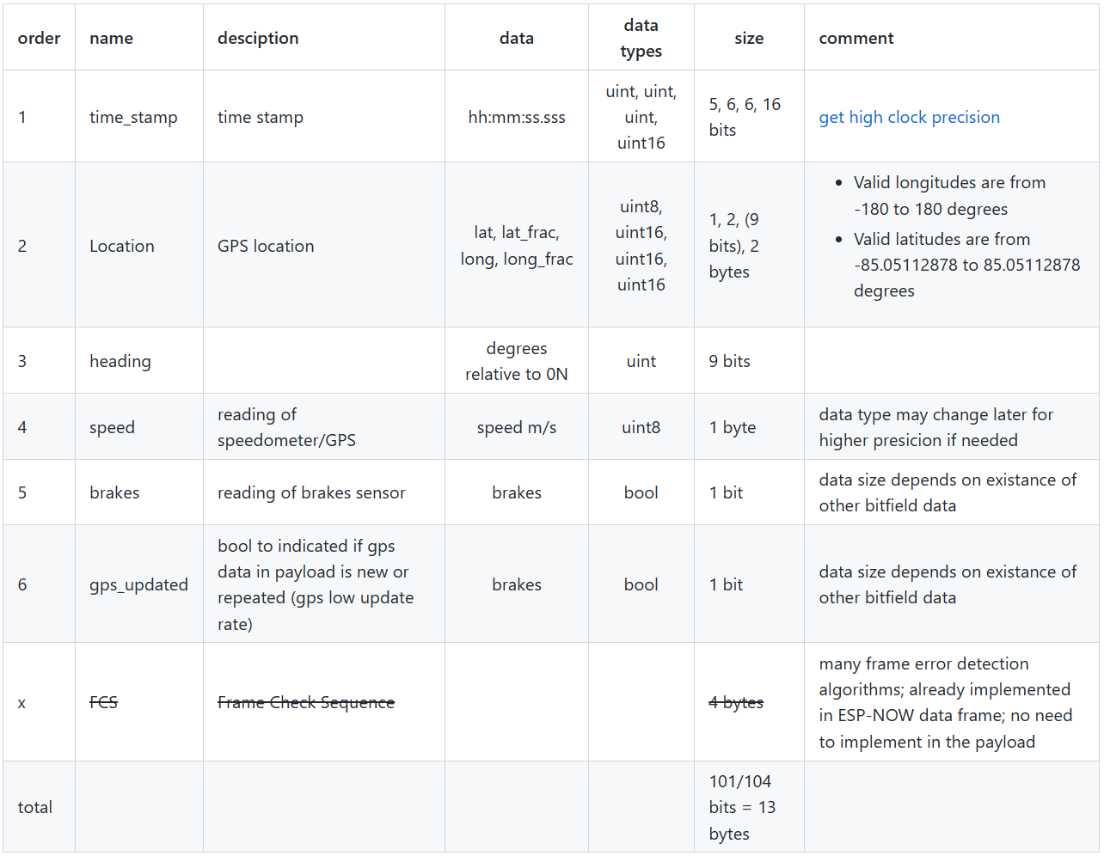
Vehicle-Telematics-Control-Unit/Efficent-encoder-decoder (github.com)

Slide 40
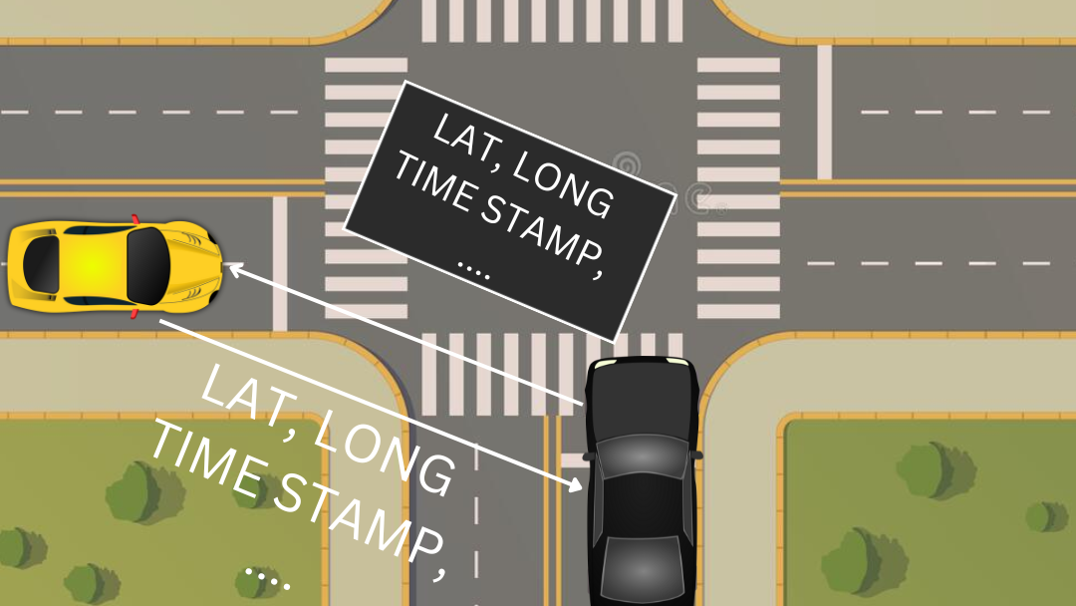
We used two approaches to send data through DSRC:
Send a payload with all vehicle’s data every time interval
During a specific interval, data gathered from ready sensors, at the end of the time interval only newly gathered data is sent (in progress)

Slide 41
Efficient Encoder/Decoder
In the first approach, we gather data from sensors then we place the data in one payload and wait for a specific time. Even if the data is not updated the old values will be placed in the payload because we need to send all data in this approach.
In the second approach, we don’t need to wait until all sensor data is ready, but we send only the data that arrived in the buffer after a specific time without waiting for the rest of the data.
We took in consider that if a brakes sensor signal arrived, we don’t wait until the specific time is finished, we immediately start sending the payload.

Slide 42
SPI to Ethernet

Slide 43
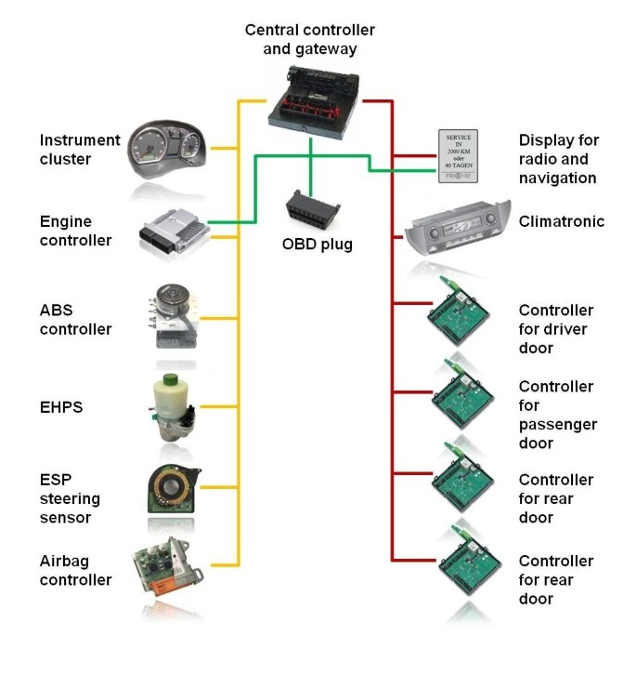
Objective
The objective of this task to figure out a way for transmitting the data from the sensors to the main ECU (raspberry pi)
At the beginning we were planning to use CAN protocol for transferring the data
But at the end we sticked with the ethernet approach for transferring the data.

Slide 44
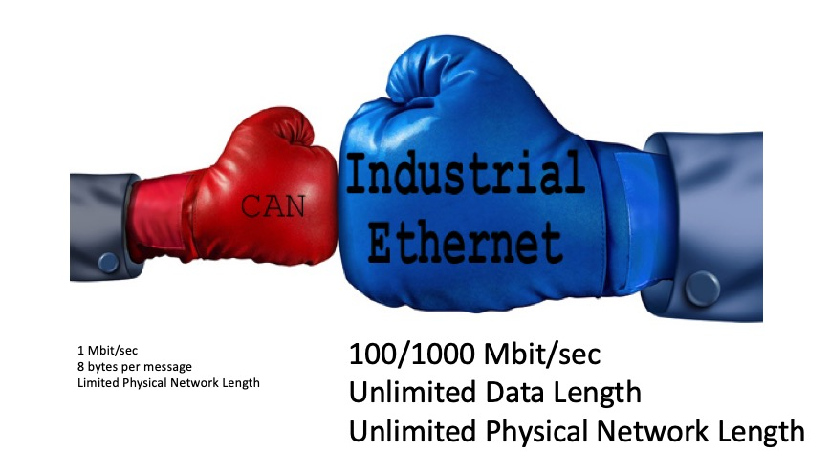
Why Ethernet?
We have chosen ethernet approach instead of can bus for several reasons.
Ethernet provides faster transmission speed (10/100 Mbit/sec compared to CAN's 1 Mbit/sec at minimal network length)
combined with a virtually unlimited amount of data (CAN Bus is limited to 8 bytes per data frame)
Valeo recommended us to use Ethernet instead of CAN protocol

Slide 45
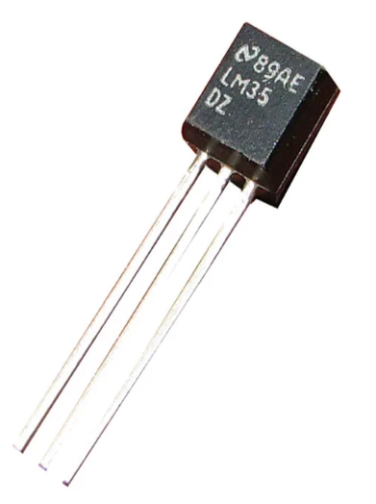
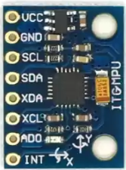
Sensors
According to our current plan we are planning to use these sensors (this plan may change in the future):
Temperature sensor
IMU sensor
Speed sensor
Brake sensor

Slide 46
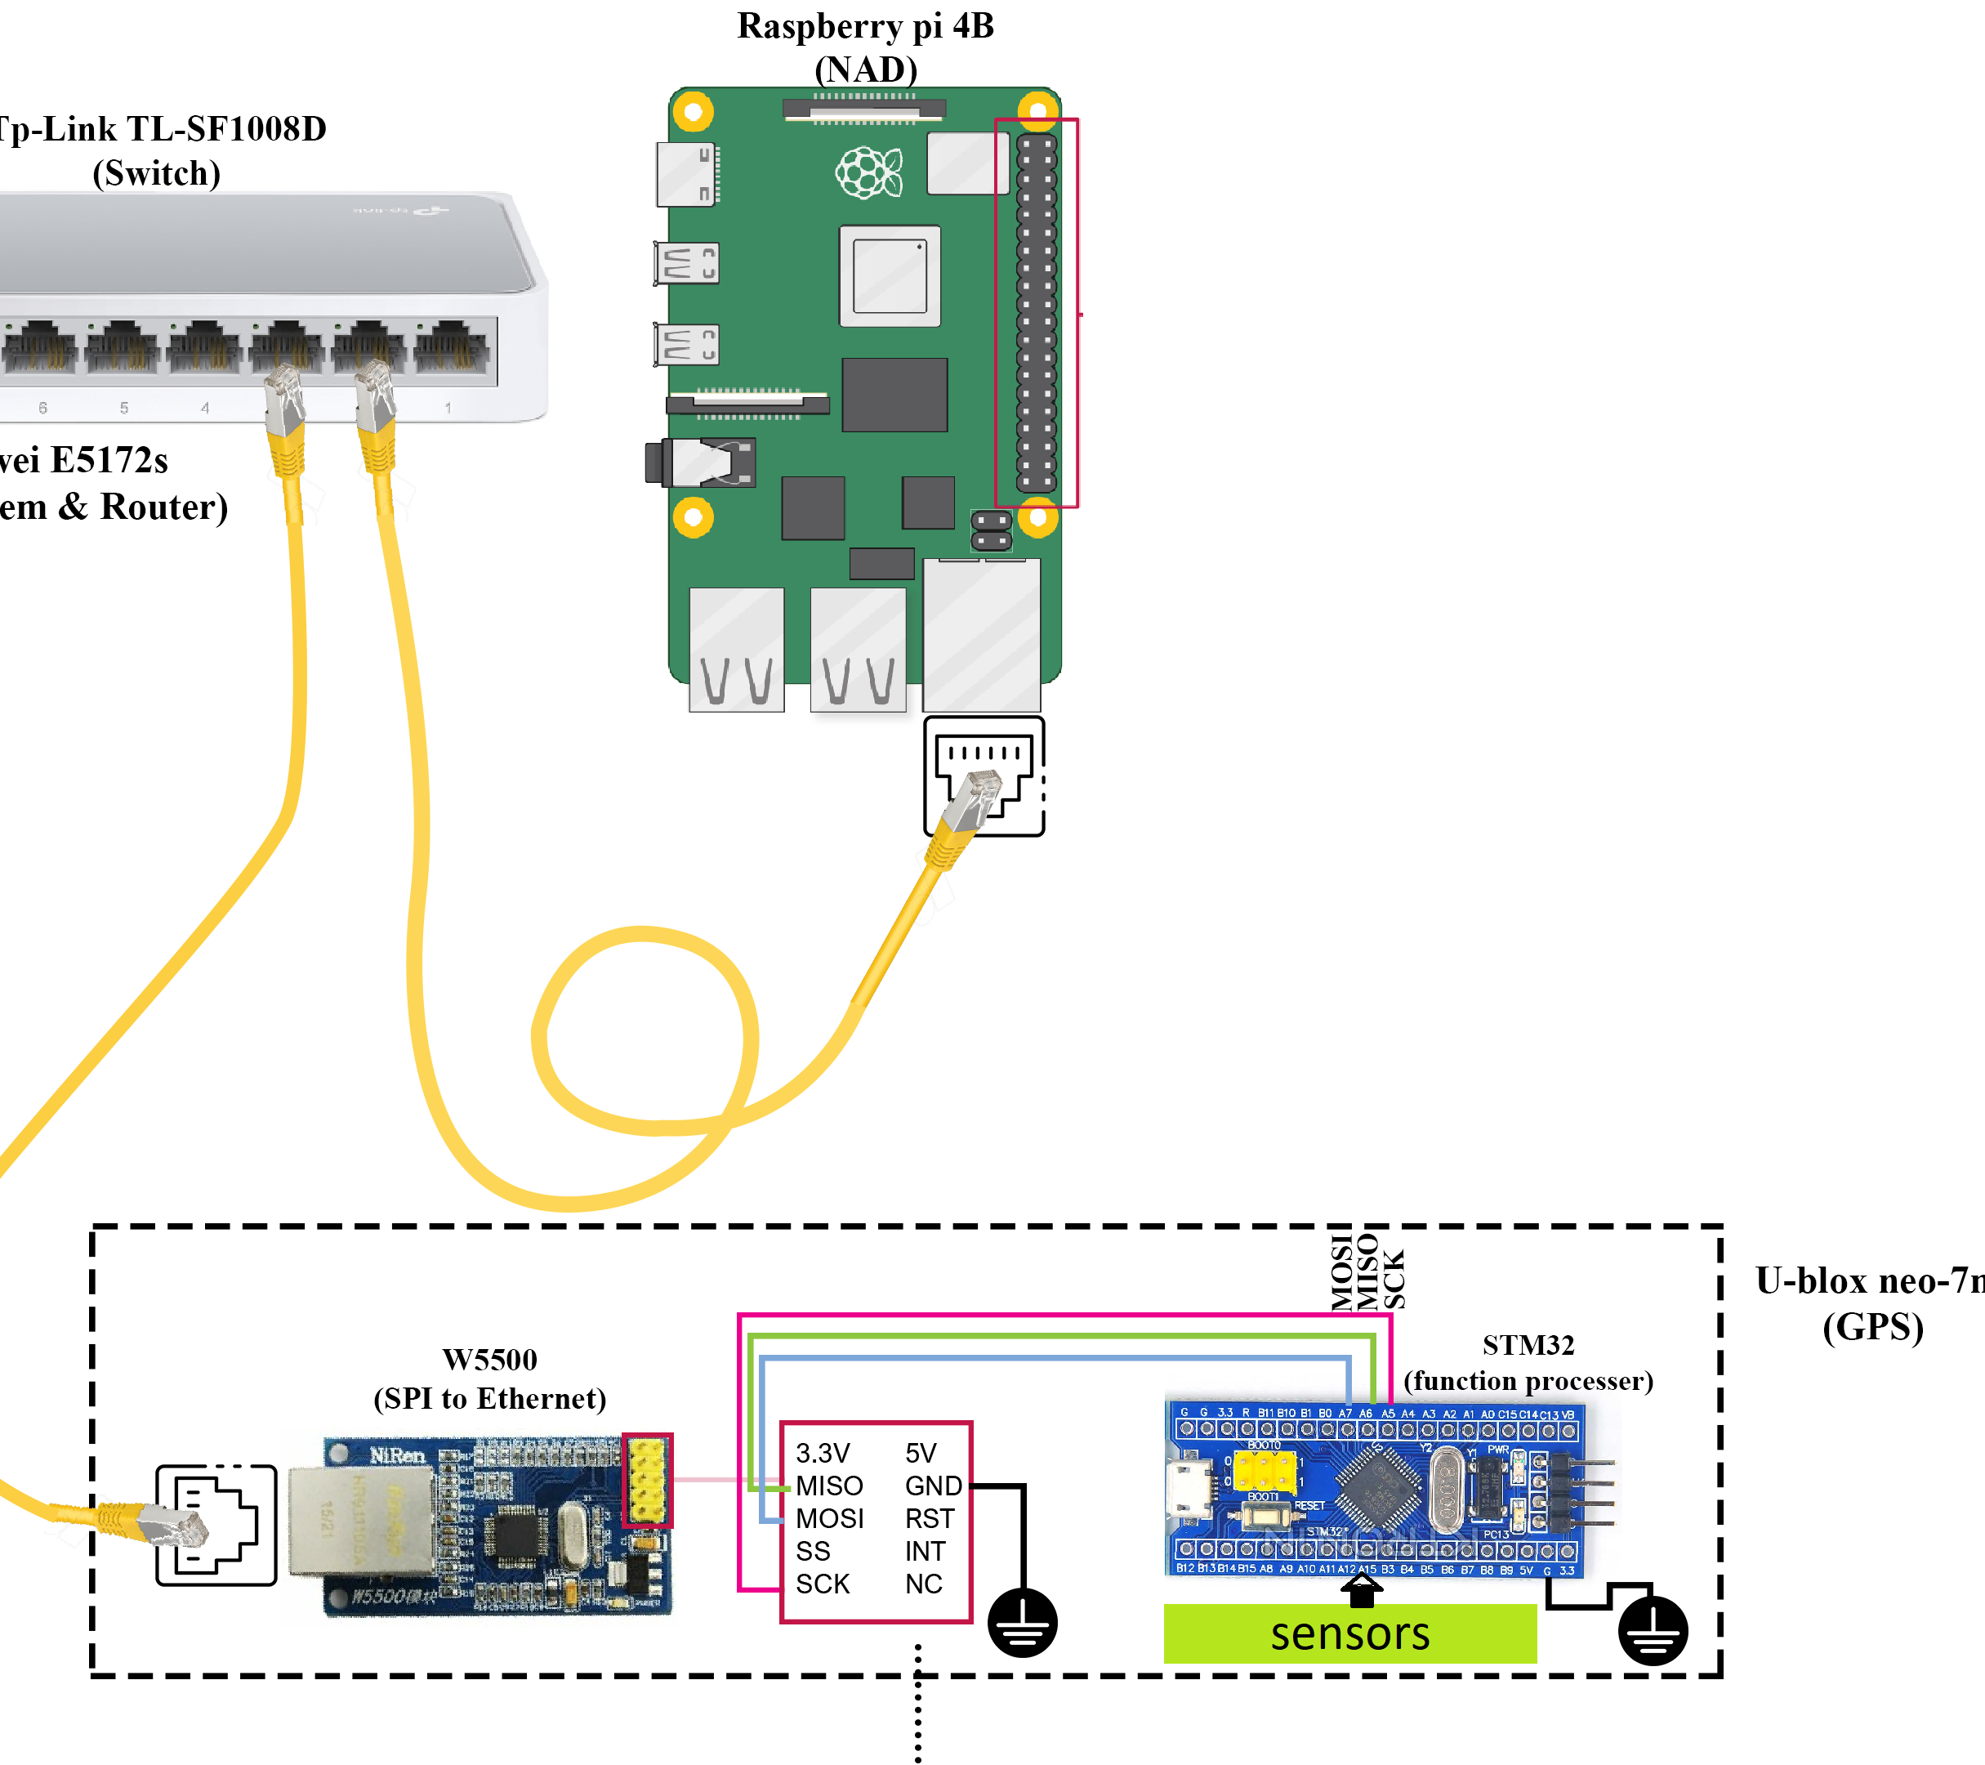
Ethernet connection
The network consists of nodes, main ECU (raspberry pi) and switch
The nodes and the main ECU are connected to a central point (switch)
Using this connection nodes which contains the data is capable of forwarding the packets to the main ECU (raspberry pi)

Slide 47
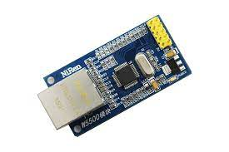
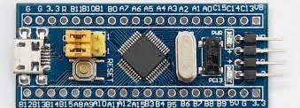
Components for a Node
Each node consists of:
W5500 (SPI-to-Ethernet module)
STM32
Specific sensors to be interfaced with STM32

Slide 48
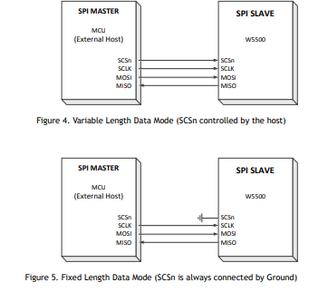
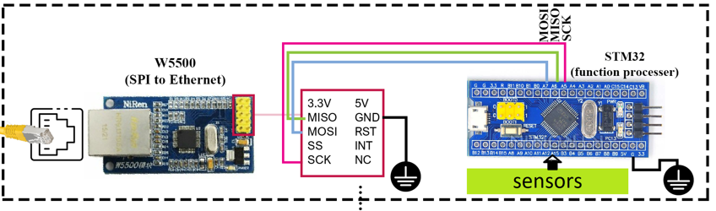
Node connection
The STM32 communicates with W5500 via SPI
The STM32 is the master where it sends commands or instructions in order to control W5500.
The W5500 is the slave where it listens to the commands or instruction sent by the STM32 and executes the ordered commands.
We are utilizing the variable length data mode

Slide 49
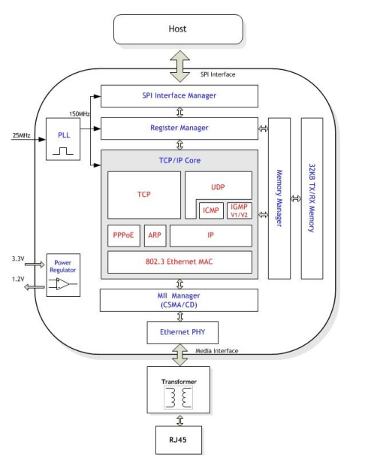
Layers of W5500
The W5500 consists of there four layers:
First layer is the SPI interface layer where the STM32 is interfaced with W5500 using SPI to be able to send commands through SPI
Second layer is the register manager where it takes the information sent by the STM32 and place it in the appropriate register location for configuring the W5500.
Third layer is the memory manager where it takes the information sent by the STM32 and place it in the appropriate memory location for configuring the W5500.
Four layer is TCP/IP layer, the W5500 has TCP/IP stack already implemented, so no need to reimplement TCP/IP stack.

Slide 50
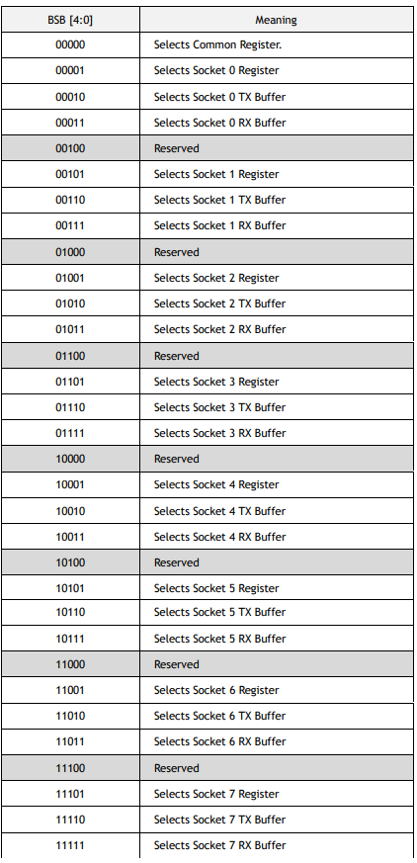
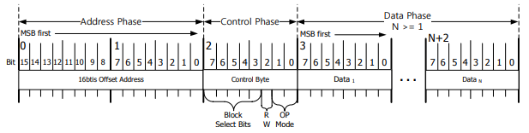
W5500 SPI frame format
W5500 consists of a common register and eight different socket registers.
W5500 SPI Frame consists of 16bits Offset Address in Address Phase, 8bits Control Phase and N bytes Data Phase
This Address Phase specifies the 16 bits Offset Address for the W5500 Registers and TX/RX Buffer Blocks. The 16-bit Offset Address value is transferred from MSB to LSB sequentially
Block Select bits select the block to which the Offset Address belongs

Slide 51
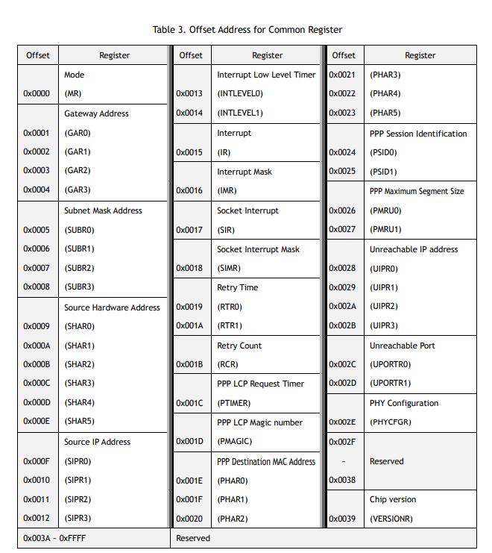
Common register
Common Register Block configures the general information of W5500 such as IP and MAC address

Slide 52
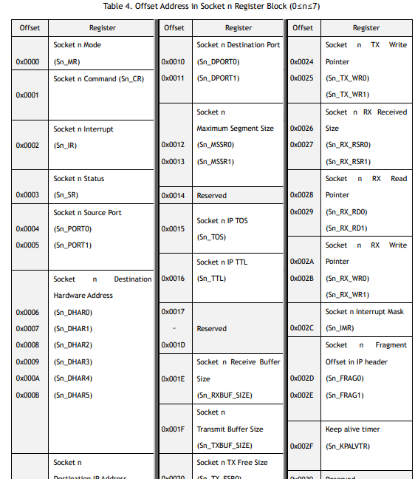
Socket register
W5500 supports 8 Sockets for communication channel.
Each Socket is controlled by Socket n Register Block(when 0≤n≤7)

Slide 53
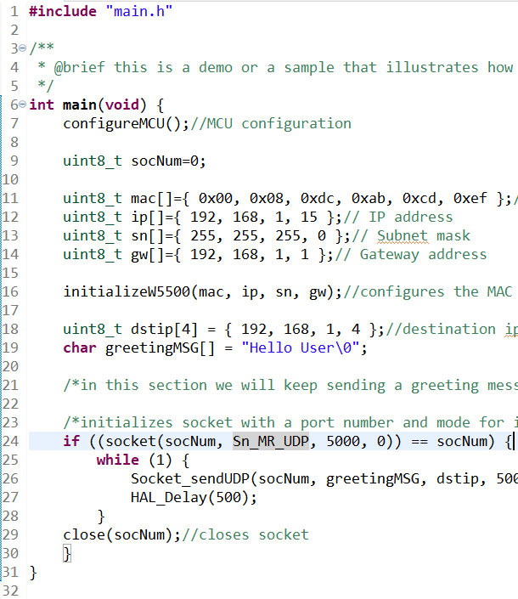
Configuring W5500
We have implemented API’s or functions for our team to make it easier to configure the W5500

Slide 54
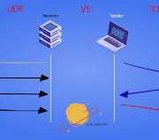
Why UDP?
UDP is chosen rather than TCP. It allows data transmission to begin faster without delays or extended latency time. There is also no need to put the packets in sequence or send and receive acknowledgments, saving time. In addition to latency, UDP is also more efficient in terms of bandwidth. These are the features that are required since we are using real-time data.

Slide 55
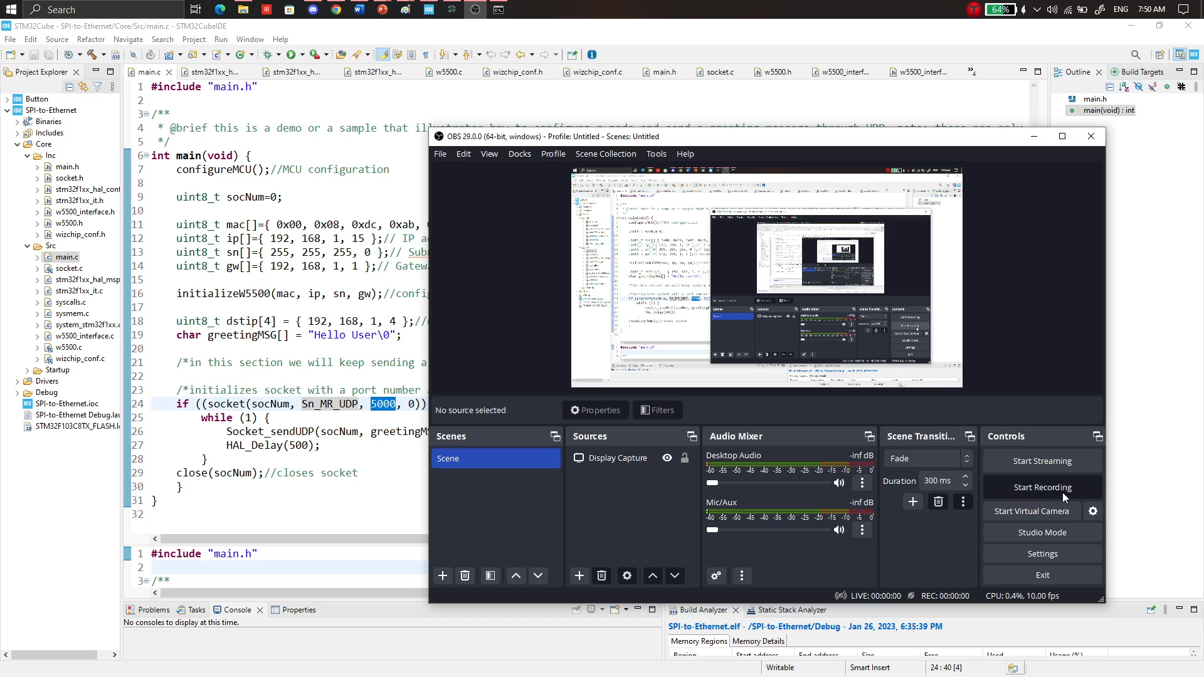
Video demonstration

Slide 56
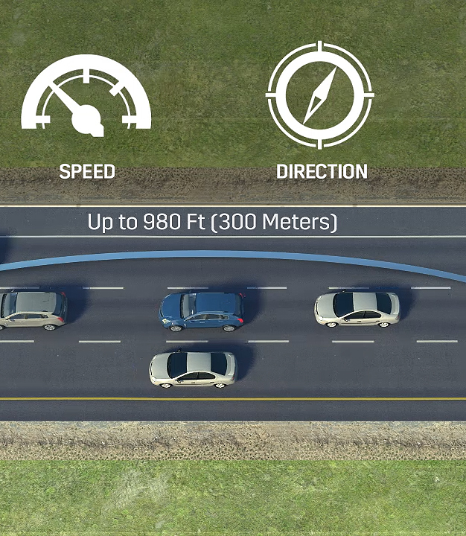
DSRC

Slide 57
DSRC
Vehicle-to-vehicle (V2V) communication’s ability to wirelessly exchange information about the speed and position of surrounding vehicles shows great promise in helping to avoid crashes, ease traffic congestion, and improve the environment.
The technology behind V2V communication allows vehicles to broadcast and receive omni-directional messages creating a 360-degree “awareness” of other vehicles in proximity using dedicated short-range communications (DSRC)

Slide 58
DSRC
DSRC (dedicated short range communication) is the hardware capable of making this dream come true by providing a direct communication between each vehicle and its surrounding vehicles (V2V) in addition to the surrounding infrastructure(V2X)
Vehicles equipped with this technology can use the messages from surrounding vehicles to determine potential crash threats as they develop. The technology can then employ visual and audible alerts—or a combination of both to warn drivers. This technique adds more awareness to the drivers to take informed actions to avoid crashes.

Slide 59
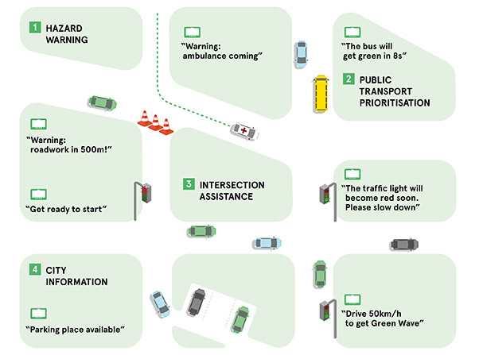
DSRC
Our plan is to integrate V2V technology into our system and create a Software that uses V2V technology to provide the following BSM (Basic safety Messages) and Traveler information message (TIM): features:
1. Hazard Warning.
2. Intersection assistance.
3. City information.

Slide 60
DSRC
Hazard warning uses V2V communication to determine potential crash threats as they develop. Then give alerts to the driver. These alerts allow drivers the ability to take action to avoid crashes.
Intersection assistance uses the same technology to give information and warnings when passing through intersection and roads where it’s hard to spot incoming cars to smooth traffic and increase the safety level when driving through those roads and decrease the possibility of creating a hazardous situation that might lead to unfortunate accidents and traffic congestion.

Slide 61
City information
Additionally, some more information may be provided for easier and more informed lifestyle. City information will be used to provide useful info about the surrounding environment such as empty parking slots, industrial Bumps, and damaged roads. This will be integrated with GPS technology to create a realistic visualization of the surrounding environment for the driver with the assistance of the surrounding vehicles.

Slide 62
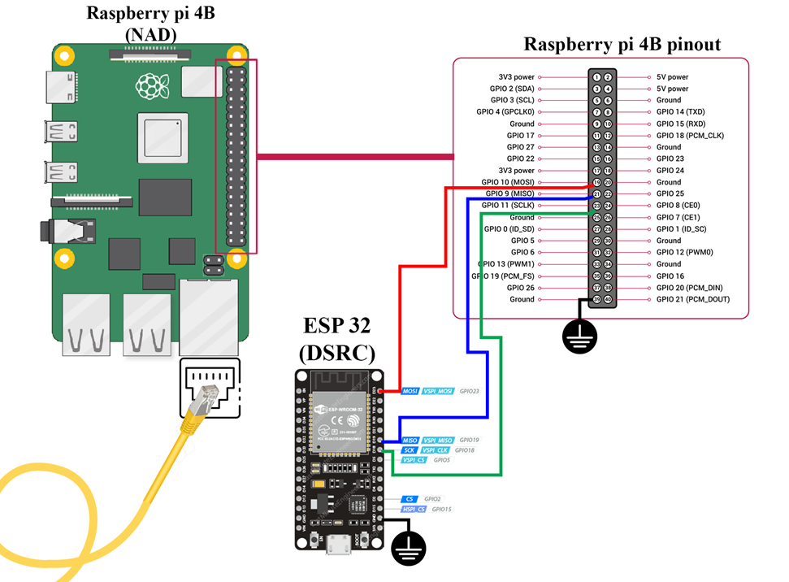
DSRC
Due to inability to have DSRC module, We have replaced DSRC module with ESP-32/8266 and ESP-NOW protocol

Slide 63
DSRC
ESP-NOW is a wireless communication protocol based on the data-link layer defined by Espressif. The big difference it makes is that ESP-NOW reduces the five layers of the OSI model to only one. In other words, the data need not be transmitted through the network layer, the transport layer, the session layer, the presentation layer, and the application layer. Also, there is no need for packet headers or unpackers on each layer, which leads to a quick response reducing the delay caused by packet loss in congested networks.
application data is encapsulated in a vendor-specific action frame and then transmitted from one Wi-Fi device to another without connection.
Additionally, ESP-NOW occupies fewer CPU and flash resources than traditional connection protocols

Slide 64
DSRC
ESP-NOW is a wireless communication protocol based on the data-link layer defined by Espressif. The big difference it makes is that ESP-NOW reduces the five layers of the OSI model to only one. In other words, the data need not be transmitted through the network layer, the transport layer, the session layer, the presentation layer, and the application layer. Also, there is no need for packet headers or unpackers on each layer, which leads to a quick response reducing the delay caused by packet loss in congested networks.
application data is encapsulated in a vendor-specific action frame and then transmitted from one Wi-Fi device to another without connection.
Additionally, ESP-NOW occupies fewer CPU and flash resources than traditional connection protocols

Slide 65
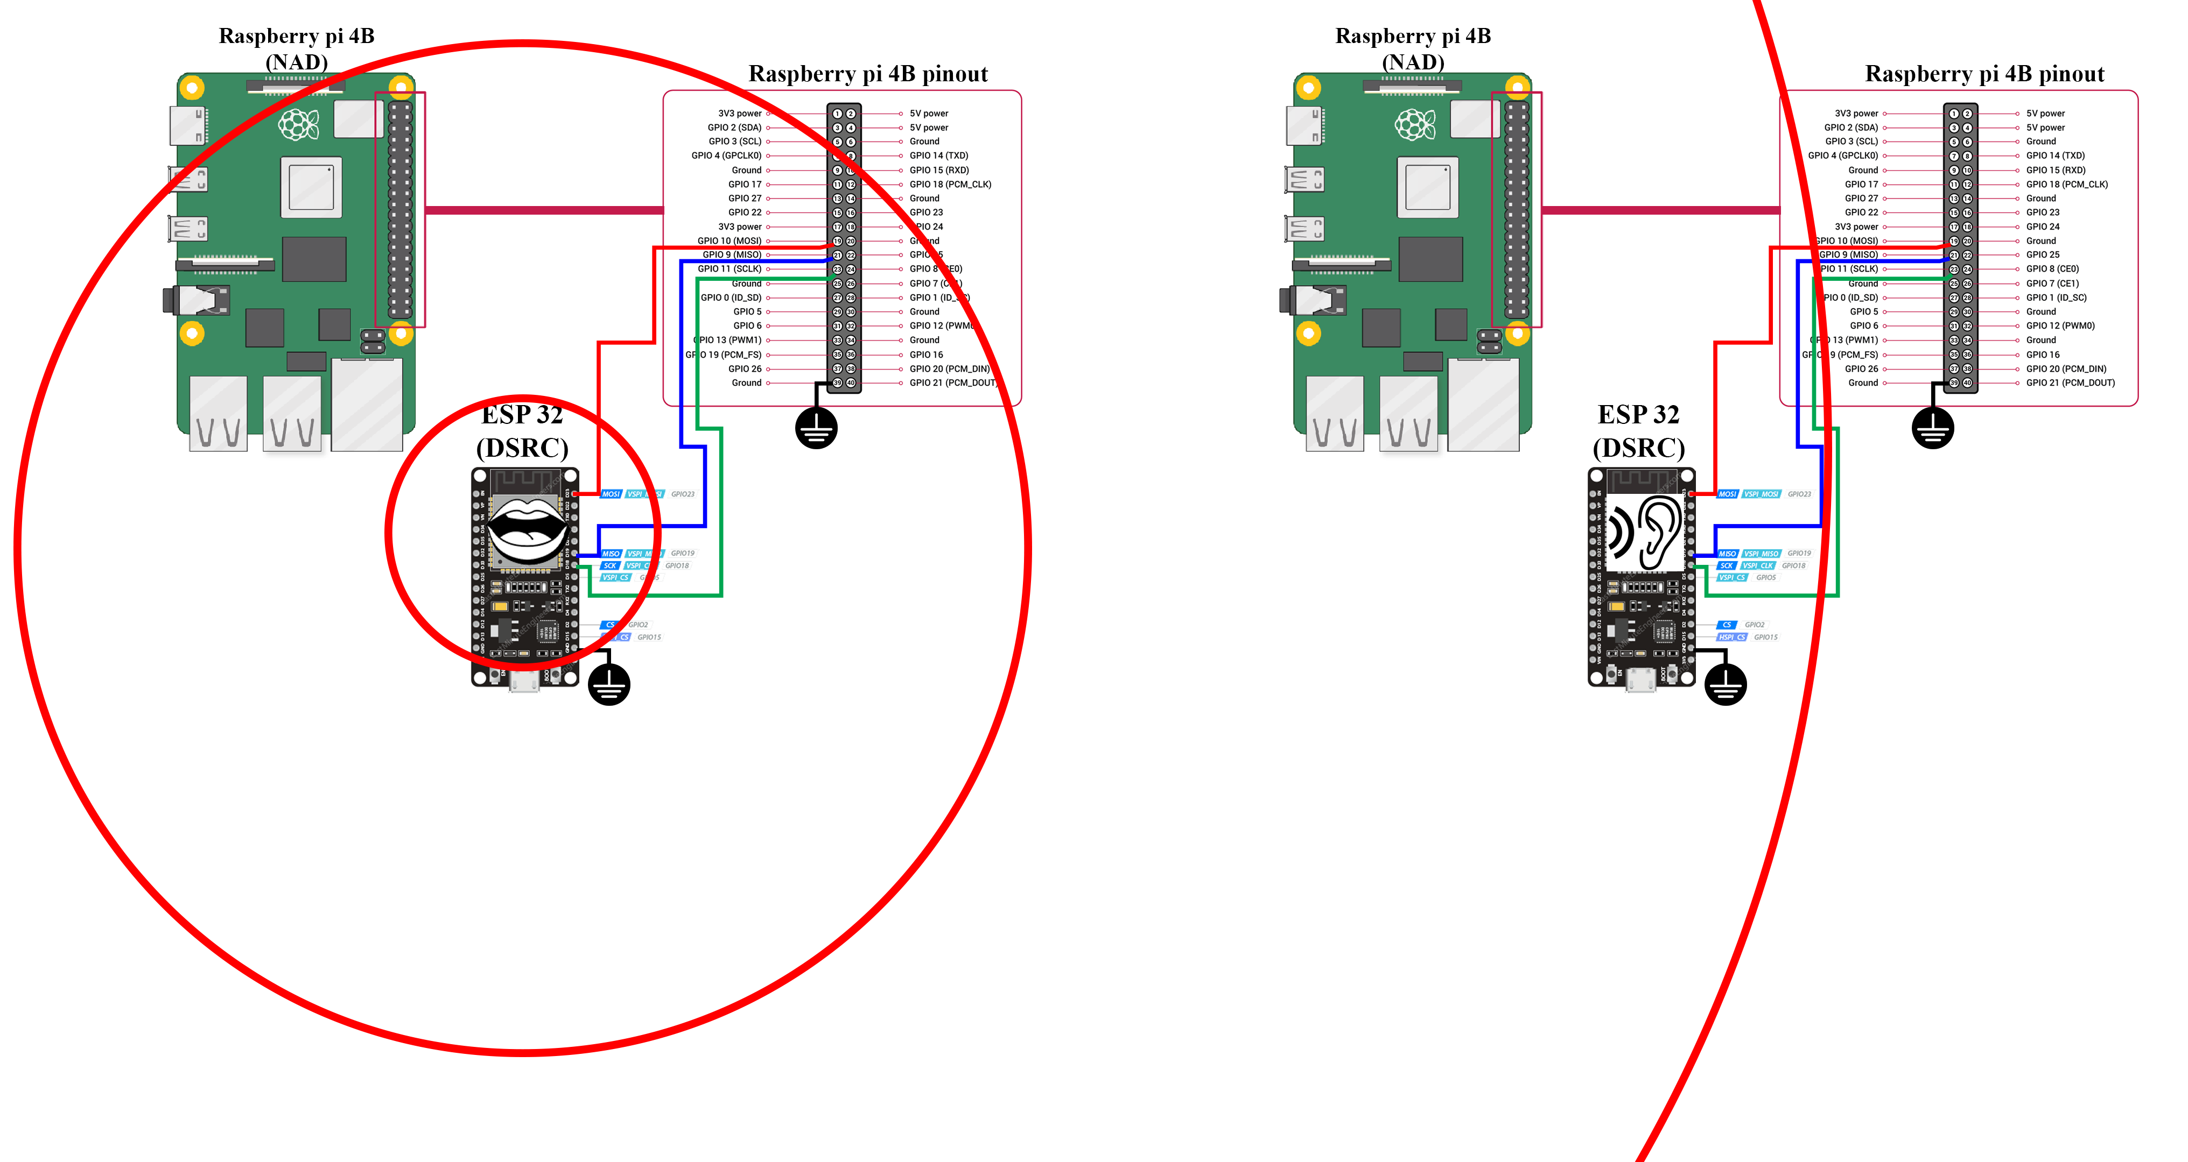

Slide 66
Category Code: The Category Code field is set to the value(127) indicating the vendor-specific category.
Organization Identifier: The Organization Identifier contains a unique identifier, which is the first three bytes of MAC address applied by Espressif.
Random Value: The Random Value filed is used to prevents relay attacks.
The Frame Check Sequence (FCS) is a part of the frame put in place to verify that the information each frame contains is not damaged during transmission. If a frame is corrupted during transmission, the FCS on the frame will not match with the recipient's calculated FCS. Any frames that do not match the calculated FCS will be discarded.
Vendor Specific Content: The Vendor Specific Content contains vendor-specific fields as follows:
ESP-NOW

Slide 67
Element ID | Length | Organization Identifier | Type | Version | Body
1 byte | 1 byte | 3 bytes | 1 bytes | 1 byte | 0~250 bytes
Element ID: The Element ID field is set to the value (221), indicating the vendor-specific element.
Length: The length is the total length of Organization Identifier, Type, Version and Body.
Organization Identifier: The Organization Identifier contains a unique identifier, which is the first three bytes of MAC address applied by Espressif.
Type: The Type field is set to the value (4) indicating ESP-NOW.
Version: The Version field is set to the version of ESP-NOW.
Body: The Body contains the ESP-NOW data.
ESP-NOW

Slide 68
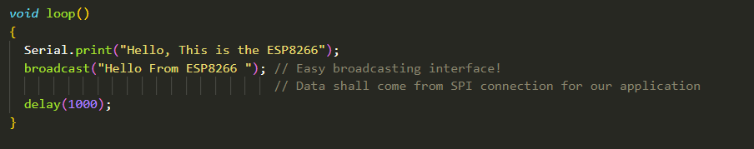
Interfacing with ESP
We managed to provide an easy interface to serve our purpose by managing all communication related work on the ESP32/8266 which broadcasts whatever data it receives through a SPI connection with the main ECU (raspberry pi) and sharing whatever data it receives with the surrounding. The sent frame already contains CRC check so its already managed by the ESP-NOW protocol and don’t need to be reimplemented

Slide 69
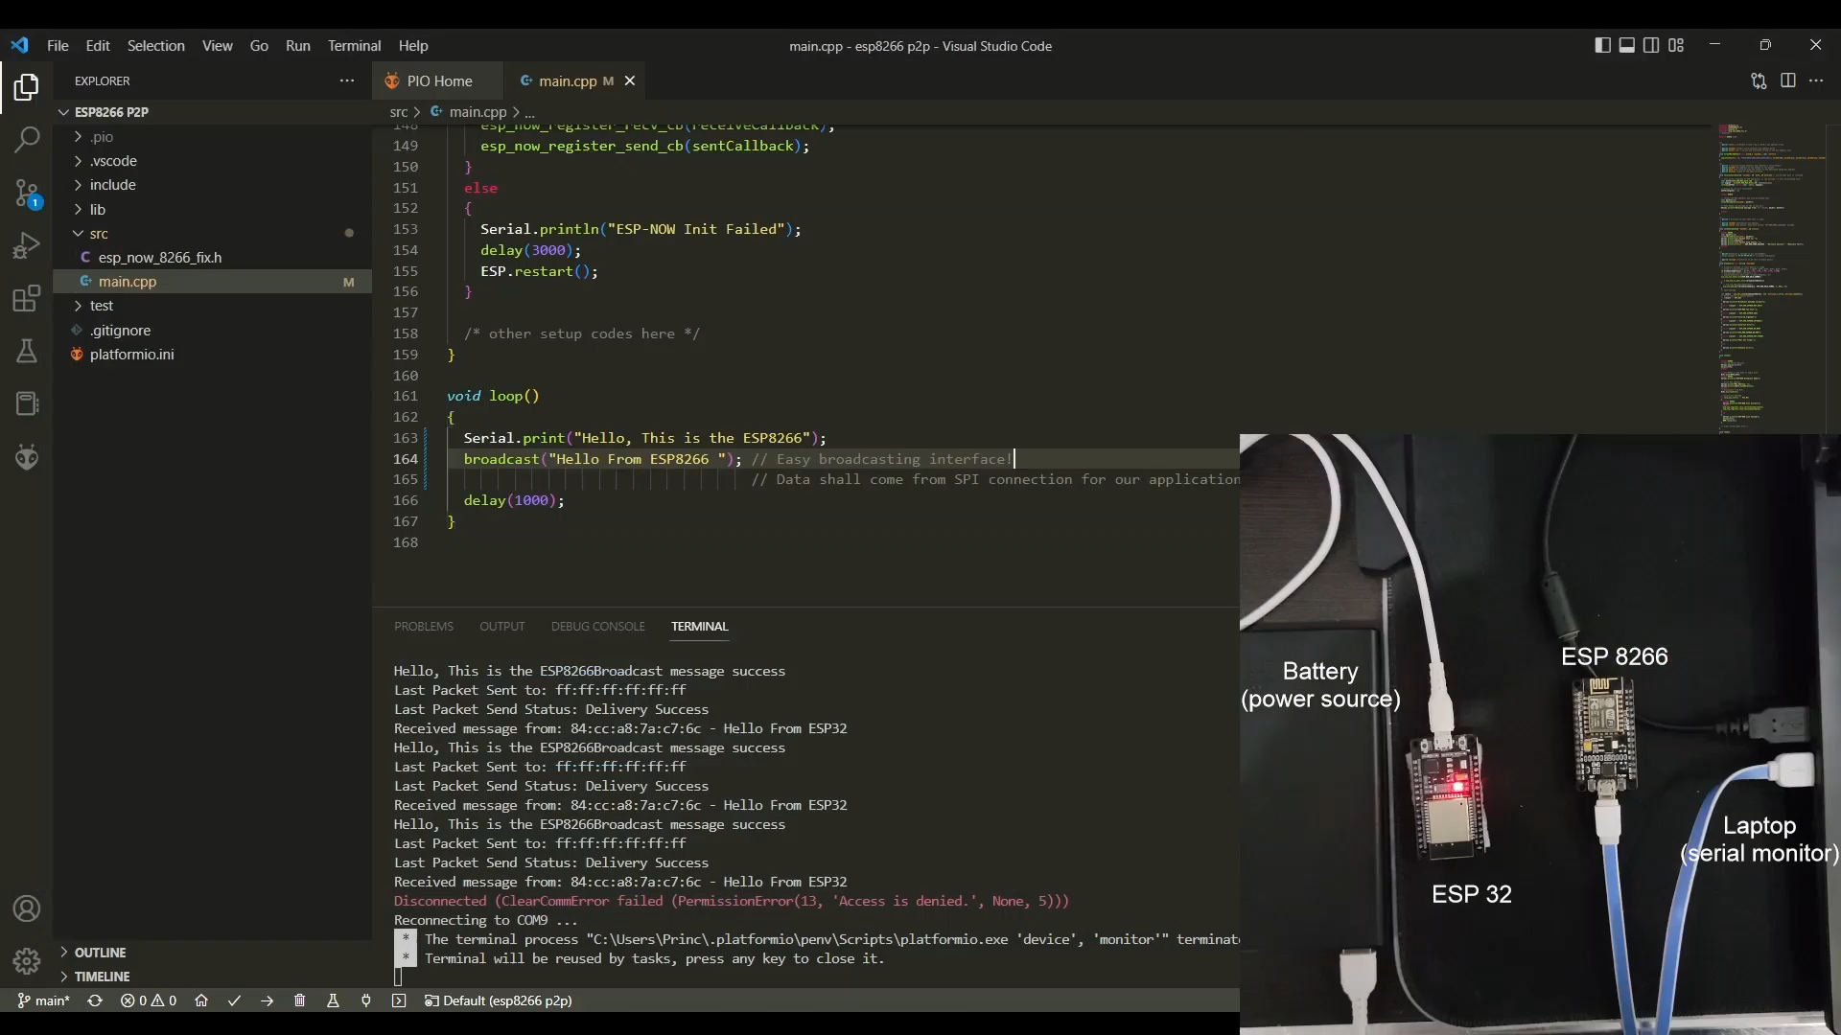
Preview

Slide 70
YOCTO

Slide 71

Despite appearing in multiple shapes and forms, embedded Linux systems are widespread across virtually every technology segment. From being open source to scalability, developer support, and tooling, myriad reasons justify why Linux is the perfect candidate for embedded appliance.
In the embedded world, the size of a full Ubuntu distribution can be enough to wipe out a board’s memory before even installing additional software or collecting data. In addition to the unnecessary services that would be running in background without any real use for our use case. When it comes to a vehicle real time project of very essential safety purpose, you need an OS that contains the essentials to run your system. This is where Yocto comes in; the goal of the Yocto Project is to provide optimized software for highly specific embedded applications.

Slide 72

Why use Yocto?

Slide 73
Sensors
+ STM32
+ SPI2Ethernet

Slide 74
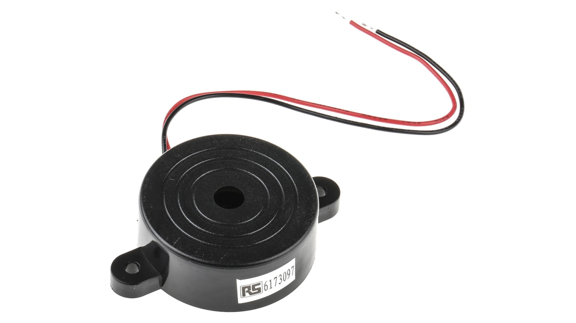
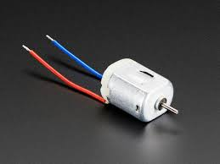
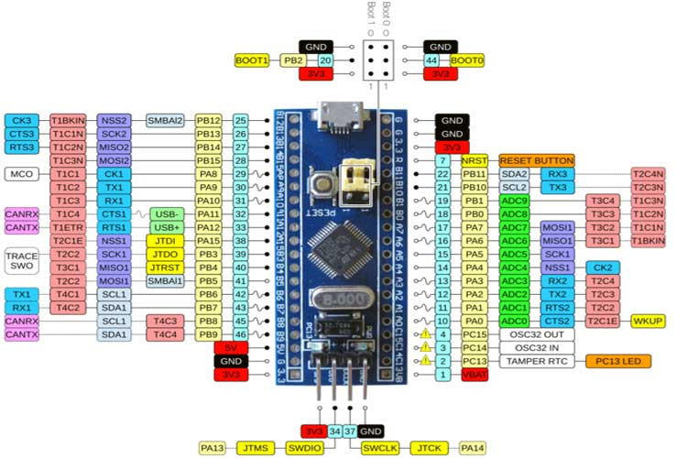
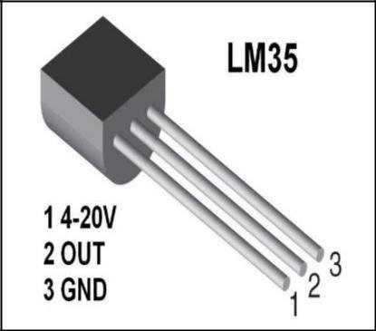
Components
Buzzer
DC motor
STM32
LM35

Slide 75
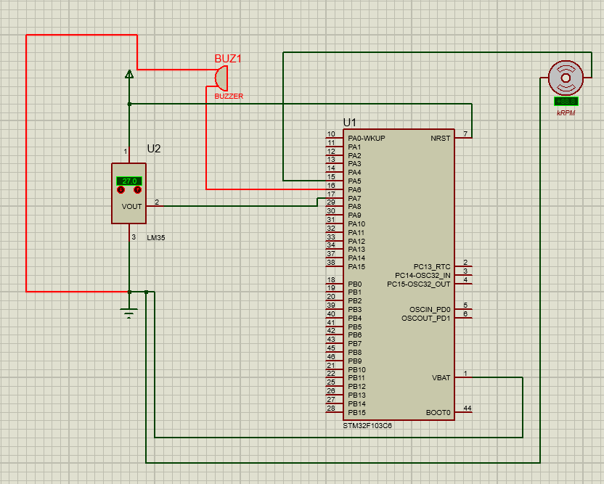
STM32 connected with Sensors
For LM35(pin2 connected PA7) with pin1(power)and pin3(ground)
For Buzzer(two pins: First pin connect to ground and second pin connect to PA6)
For DC Fan(two pins: first pin connect to ground and second pin connect to PA5)

Slide 76
How it works?
When temperature(LM35) increased, the fan dc stop then buzzer rings as this signal for user to check for car engine or thermostat of car

Slide 77
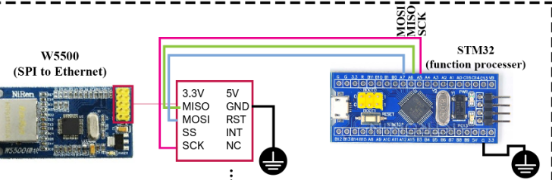
Prototype
After we connect STM32 with sensors, we need to connect SPI to Ethernet(W5500) as STM32 doesn’t has Ethernet port to take signal data from STM32, so W5500 in order to make communication between STM32, Raspberry pi.

Slide 78
Cloud development integration

Slide 79

Web and cloud-based applications became a major part in any system no matter what the field is. Major vendors now look forward to make benefits of these technologies and integrate them with their systems.

Slide 80




The tycoons of the automotive industry have started taking some steps on order for this to happen. from those major steps is:
forming the e-Sync alliance for creating a high-confidence multi-vendor path to creating end-to-end secure OTA and data services for the connected car through a global network of co-operating suppliers.
Standards for these software have been created like
UN-R155 which illustrates the security standards for all applications that use the networks.
UN-R156 which illustrates the importance of creating a software update management system for any software before it's published to the market and each version identification requirements.

Slide 81
Our purpose is to create a companion web application that complies with these standards to be familiar with them and be able to create applications at that level after our graduation. So, we decided to implement Vehicle plus.
The application is concerned with certain issues which are:
Providing services for the automotive owner to facilitate its usage.
Continuously updating the owner about his vehicle.
Creating a SUMS system for the TCU software.
Provide cloud-based API services to aid the TCU in increasing its efficiency.
Prevent hazards that a user might face due to bad usage of his vehicle.

Slide 82


Slide 83
App Modules

Slide 84
App Modules
Back-End server + mobile application

Slide 85
Login to his primary device
When the User purchase his new vehicle, An account is created and registered to the purchased vehicle as it's owner.
After the initial login, the user will be asked to activate his account using the verification method provided on the account creation.
1
2
After account activation the User is now connected to his vehicle and can access its features.
3

Slide 86
Share vehicle access with other devices via primary device
By sending a request to the server to share access, containing vehicle and device IDs ,The server will check if it’s a primary device to create new device connection request record.
Then reply with a randomly generated token that will be used for authentication otherwise it will return error 403 (Forbidden).
The new device will send the token with its info to the server in a POST request to be connected to the vehicle. The server will check if the device's token matches that of the request and return code 200 (successful request) If it's pending, then will create a new device record with user's account and prevent this device from sharing access.

Slide 87
Be warned if the vehicle is being accessed when his phone is away from his vehicle
The vehicle will send a POST request to the server containing its location to check if a device connected to it is nearby
if The device responds saying that something is wrong
if the device can trigger crisis management protocol
Apply that protocol
else
re-notify the users that can trigger the crisis management protocol
1
The server will lookup the last known location of the devices connected to that vehicle and find the distance between them and the vehicle
If the distance between any device and the vehicle exceeds a certain tolerance. An alert will be sent to that device to check if that is okay
2
3
4

Slide 88
Request vehicle live location
The mobile device sends to the server the TCU id requesting its live location
The server will search for the TCU using it’s IP address. If it’s reachable.
The server will send to the TCU the mobile device IP address requesting it to share its location
1
The server will acknowledge the mobile device for it to open a socket with the TCU IP address and the port
2
3
The TCU will start streaming its live location coordinates to the mobile device on the opened port
4

Slide 89
Access live diagnostics information from his vehicles.
The server will deserialize the response a process the information and extract the status codes in the requests.
The server will get the status codes descriptions from the data base and generate a JSON response containing this descriptions and the severity of the code.
he sends a request to the server containing the vehicle ID requesting the vehicle diagnostic information.
1
The server will lookup the vehicle using it's ID to get it's IP address. The server will send a get request to the vehicle using the recovered IP asking for it's diagnostic information.
2
3
The server will return that response to the User
4

Slide 90
Receive an alert instant if any malfunction occurs.
the vehicle sends a request to the server containing the error code to the server.
The server will lookup the devices connected to that vehicle ID to get their IP address. The server will send a POST request to the device using the recovered IP to notify it.
1
The server will get the status codes descriptions from the data base and generate a JSON response containing this descriptions.
If the device replies with code != 200 The server schedule sending those alerts the next time the device is connected to the internet
2
3
4

Slide 91
App Modules
Admin console

Slide 92
Connect the vehicle owner's primary device to vehicle on purchase
the manufacturer receives the owner information
the manufacturer sends a POST request to the server containing the TCU Id and the User information
1
2
The server will create a new user record and register this user as the owner to vehicle requested.
3

Slide 93
Register that a new software update has been released
the manufacturer sends a POST request to web server with the RXWIN of the new update.
the server will notify the automation server that an updated version of the software has been released
the automation server will iterate through all the vehicles and send a request to devices connected to that vehicle telling them to update their vehicles software.
1
2
3
each 24 hours the automation server will repeat the previous step
4

Slide 94
System architecture

Slide 95

Data base Level

Slide 96
The back-bone Data Base system for our modules
01
Easy to update and research data accurately and in a secure manner
More efficient when handling large huge amounts of information that need on the spot organization and update automatically using it's functionalities like indexed views and stored procedures
04
02
Having data organized in an efficient way will help us make statistical and quantize analysis for them providing important conclusions that help vehicle manufacturers forecast their next step using data science and AI
The most efficient way to logging and accounting system interactions providing the aspect of integrity which is critical for an enterprise level solution
03

Slide 97

PostgreSQL
It's a very powerful, open-source object-relational database system, it uses SQL with other features to store data in a safe way.
It's free open-source with no licensing cost or charge.
Variety of data types as it includes
Geometrics (point/line..) Document (JSON..) Structures (Date/time..) .
WHY POSTGRESQL?
It's reliable and proven for its data integrity and feature set robustness.
Easily integrated by standard SQL interface with other databases. ​

Slide 98

ERD Diagram

Slide 99

Relational Schema

Slide 100

Redundancy and replication
Docker combined with Kubernetes will be used for service orchestration using stateful sets
Stateful Sets are valuable for applications that require one or more of the following :
Stable, unique network identifiers.
Stable, persistent storage.
Ordered, graceful deployment and scaling.
Ordered, automated rolling updates.

Slide 101
Application logic

Slide 102

.NET CORE V6
.NET 6 delivers the final parts of the .NET unification plan that started with .NET 5. .NET 6 unifies the SDK, base libraries, and runtime across mobile, desktop, IoT, and cloud apps. In addition to this unification, the .NET 6 ecosystem offers
New language features in C# 10 reduce the amount of code you need to write. And investments in the web stack and minimal APIs make it easy to quickly write smaller, faster microservices.
its own build in security system which is the identity framework
Easy integration with most SQL data base systems using the entity frame work​
.NET core frame works are platform independent. So, it’s can easily run on Linux or be containerized

Slide 103
UI and interfacing

Slide 104

Angular
Angular is a platform and framework for building single-page client applications using HTML and TypeScript. Angular is written in TypeScript. It implements core and optional functionality as a set of TypeScript libraries that you import into your applications.
Angular is an open-source front-end framework developed by Google for creating dynamic modern web apps.
Angular helps build interactive and dynamic single page applications (SPAs) , hence it ensures lighter and faster apps
Built using TypeScript as it supports types which ensures higher security.
It has multiple features such as MVC pattern, directives, two way data binding ,and dependency injection.

Slide 105

Flutter
Flutter is Google's open-source technology based on Dart for creating mobile, desktop, and web apps with a single codebase
Flutter uses the Skia Graphics Library which is a fast and mature open-source graphics library. It redraws the UI every time a view changes. The result? A quick loading and smooth app experience.
One of the benefits of using Flutter is that you can modify or customize widgets with ease.
With Flutter there is no need to reload the app to see every single change you make in the code. The hot reload feature make the app development much quicker. You can easily make changes in your app in real time and have it updated
Flutter provides advanced OS features like GPS coordinates, sensor data collection, permission handling, Bluetooth, credentials, and other features in ready-to-use plugins that are supported by Google.

Slide 106


Slide 107
Implementation

Slide 108


Development Model
Under a DevOps model, development and operations teams are no longer "siloed". Sometimes, these two teams are merged into a single team. Quality assurance and security teams may also become more tightly integrated with each other and with the application lifecycle. This is sometimes called DevSecOps.

Slide 109


Slide 110

CI/CD in DevOps
Continuous integration is a software development practice where developers regularly merge their code changes into a central repository, after which automated builds and tests are run. The key goals of continuous integration are to find and address bugs quicker, improve software quality, and reduce the time it takes to validate and release new software updates.
Continuous delivery is a software development practice where code changes are automatically built, tested, and prepared for a release to production. It expands upon continuous integration by deploying all code changes to a testing environment and/or a production environment after the build stage. When continuous delivery is implemented properly, developers will always have a deployment-ready build artifact that has passed through a standardized test process.

Slide 111

Jenkins
Jenkins is an open-source automation server. It helps automate the parts of software development related to building, testing, and deploying, facilitating continuous integration and continuous delivery. It is a server-based system that runs in servlet containers such as Apache Tomcat. It supports version control tools, including AccuRev, CVS, Subversion, Git, Mercurial, Perforce, ClearCase and RTC, and can execute Apache Ant, Apache Maven and sbt based projects as well as arbitrary shell scripts and Windows batch commands.

Slide 112

Infrastructure as code
Configuration Management
Developers and system administrators use code to automate operating system and host configuration, operational tasks, and more. The use of code makes configuration changes repeatable and standardized. It frees developers and systems administrators from manually configuring operating systems, system applications, or server software.
Policy as Code
With infrastructure and its configuration codified with the cloud, organizations can monitor and enforce compliance dynamically and at scale. Infrastructure that is described by code can thus be tracked, validated, and reconfigured in an automated way. This makes it easier for organizations to govern changes over resources and ensure that security measures are properly enforced in a distributed manner (e.g., information security or compliance with PCI-DSS or HIPAA). This allows teams within an organization to move at higher velocity since non-compliant resources can be automatically flagged for further investigation or even automatically brought back into compliance.

Slide 113

Micro services
The microservices architecture is a design approach to build a single application as a set of small services. Each service runs in its own process and communicates with other services through a well-defined interface using a lightweight mechanism, typically an HTTP-based application programming interface (API). Microservices are built around business capabilities; each service is scoped to a single purpose. You can use different frameworks or programming languages to write microservices and deploy them independently, as a single service, or as a group of services.

Slide 114


Slide 115

Communication and Collaboration
Increased communication and collaboration in an organization is one of the key cultural aspects of DevOps. The use of DevOps tooling and automation of the software delivery process establishes collaboration by physically bringing together the workflows and responsibilities of development and operations. Building on top of that, these teams set strong cultural norms around information sharing and facilitating communication through the use of chat applications, issue or project tracking systems, and wikis. This helps speed up communication across developers, operations, and even other teams like marketing or sales, allowing all parts of the organization to align more closely on goals and projects.

Slide 116
Our collaboration system

Slide 117
Thank you

